Slide 1
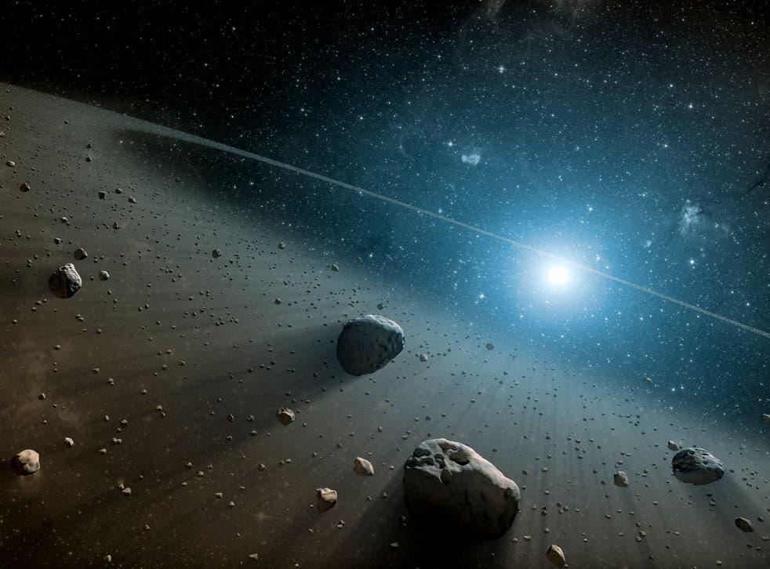
Asteroid Orbits
Michael Harrington

Slide 2
How accurate of a classification machine learning model can be constructed to predict the orbit type of Asteroids?

Slide 3
Introduction and Goal
Goal of project was to create a multi-class classification machine learning model to effectively and efficiently predict the orbit type of Asteroids located in our solar system
A successful model could be useful for variety of institutions in academic, government or private sectors
Particularly among aerospace related companies and agencies (NASA, SpaceX, ESA, etc.)
The dataset used was found on kaggle.com with it’s original source being the minorplanetcenter.net
Link to dataset - Asteroids
The target feature, orbit type, contains 11 unique classes and is extremely imbalance
MBA class is about 90.5% of Asteroids in dataset - vital to keep in mind when modeling, looking for models to achieve especially high accuracy scores to be useful

Slide 4
Data Wrangling and Cleaning
Initial dataset was very large - over 1 million rows and 30 plus features
Due to its great size I decided to take a random sample of 20% of the dataset for computational efficiency
Varied the ratios of the target features stayed approximately the same to ensure validity of model built on it
Data was generally in a very clean state - only really had to deal with missing values and few other simple tasks such as renaming columns for clarity
Numeric features missing values imputed with median, the few categorical features had just a small number of missing values and thus were simply dropped
Dataset contained several features clearly unusable for modeling - such as various reference codes, flags and name and number
These features were consequently dropped
A few additional features related to orbits were extracted from existing features

Slide 5
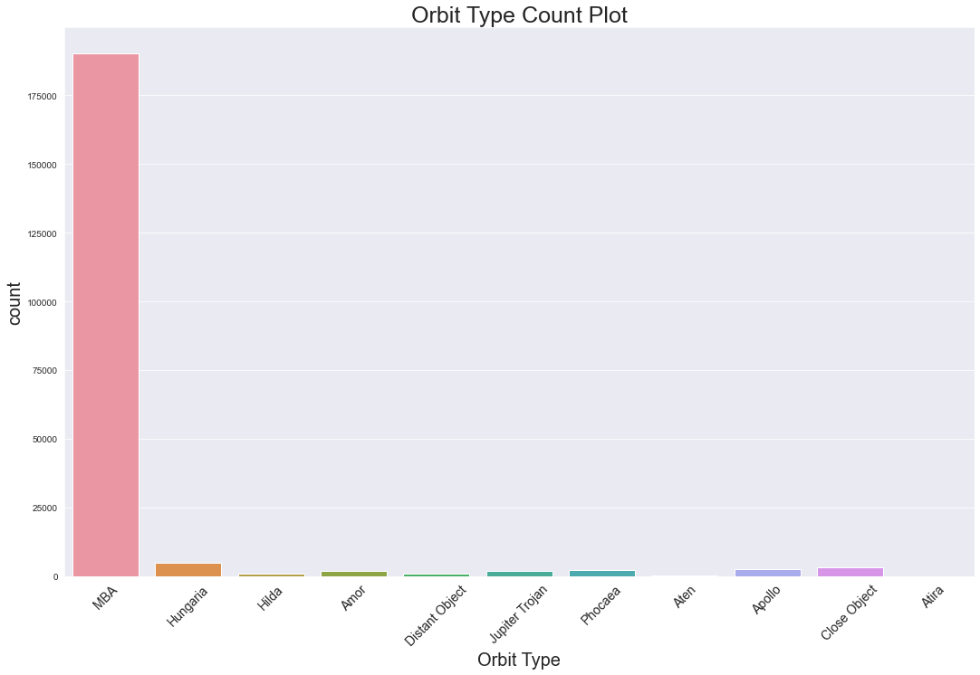
Orbit Type Distribution
An in depth look at the distribution of the target feature - Orbit Type
The extreme imbalance of the classes is clearly obvious
MBA is the majority class - as mentioned before approx. 90.7% of the dataset
Most of the other classes represent roughly 1% of the Asteroids each
Atira is the one extreme outlier - makes up only 8 of the Asteroids in the final dataset
Often very difficult to model and predict such a small class

Slide 6
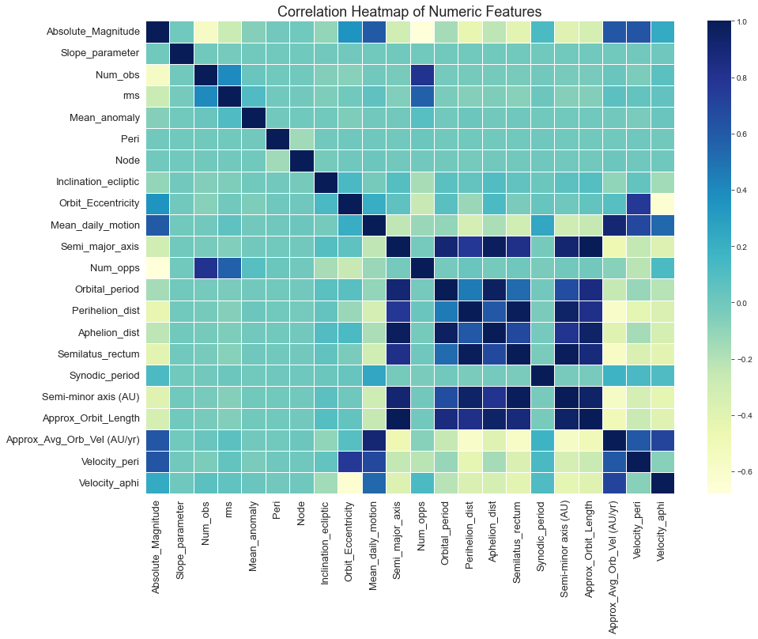
Numeric Features
Correlation heatmap comparing all the numeric features in the dataset
Several of these features were created using extant knowledge on existing features
Specifically Semi-minor axis through Velocity aphi
A few features do seem to be quite collinear - such as semi-latus rectum, perihelion dist, semi-minor axis etc.
May impart the same information to a predictive model and thus make it less interpretable

Slide 7
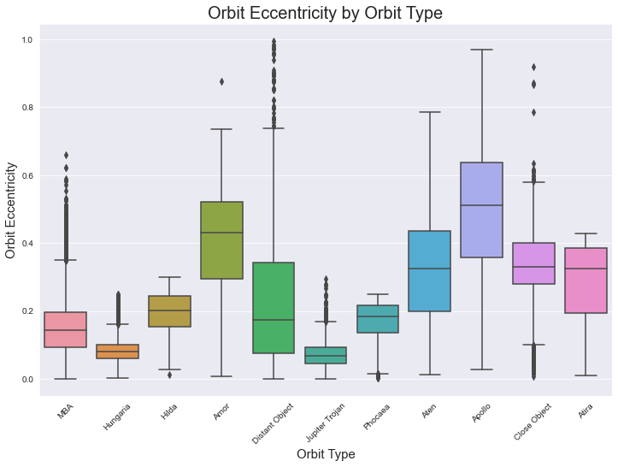
Orbit Eccentricity
Boxplot of orbit eccentricity feature separated by orbit type
Wanted to examine eccentricity in depth
Believe it will be important feature in modeling
Some classes show strongly clustered values (Hungaria, Jupiter Trojan) and others huge variance (Distant Object, Apollo)
Orbits tended to more elliptical than my intuition suspected - many with relatively elongated, squished orbits

Slide 8
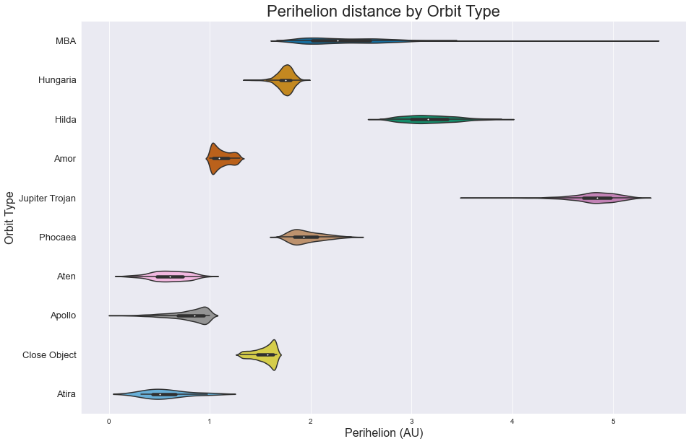
Perihelion
A violin-plot of the perihelion distance of Asteroids by orbit type
Perihelion is the point of an orbit where a rotating object is closest to the sun
Here in units of Astronomical Units (AU) - where AU is the mean distance of Earth from Sun
Plot shows some pretty clear differentiation by orbit type

Slide 9
Pre-Processing
Very straightforward for this dataset
Data separated into target and predictor arrays
Categorical features one-hot encoded and one datetime feature converted to numeric
Train test split performed on target and predictor feature arrays utilizing a 70/30 train/test split
Train and Test predictor arrays standardized

Slide 10
Modeling
Wanted to compare the effectiveness of a good variety of algorithms
Ended up comparing four primary standard classification machine learning algorithms - (Logistic Regression, Decision Trees, SVM, and Random Forests)
All using the Scikit Learn library
Also implemented a simple Neural Network using Keras
A Naive Bayes model, GaussianNB specifically, was tried but ultimately ignored due to ineffectiveness

Slide 11
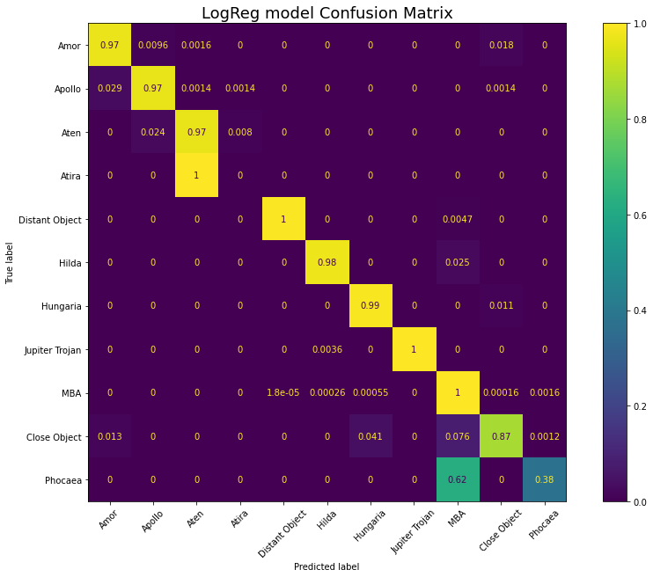
Logistic Regression
Wanted to try a simple linear model first - went with Logistic Regression
Properly set for multi-class support
Surprisingly impressive results on test set
Model achieved accuracy score of 0.988273
Macro average precision, recall, and f1-scores of 0.86, 0.83 and 0.84 respectively
Normalized confusion matrix shows results - model performed well on all classes outside of Atira (which has just 3 examples in test set) and Phocaea (which it often misclassified as MBA)
Hyperparameter tuning yielded model that performed essentially the same (minutely better) but took exponentially longer to fit and make predictions

Slide 12
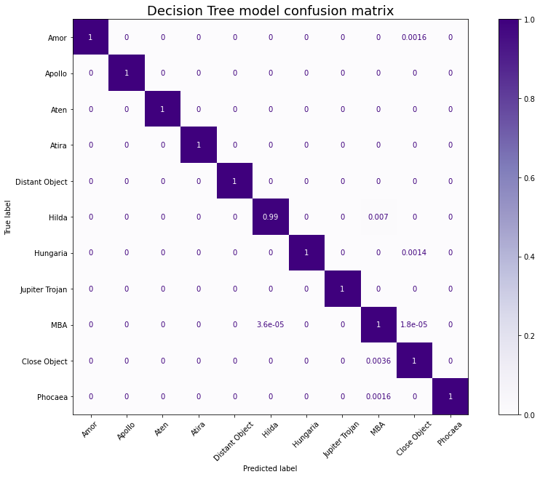
Decision Tree Classifier
Wanted to try a tree based model next. Went with the basic Decision Tree first
Models with criterion set to both gini and entropy were tested - entropy model proved slightly better
Model performed unbelievably well on the test set - accuracy score of 0.9998
Macro Average precision, recall, and f1-scores of 1.00 each
Normalized confusion matrix of the model results located in plot

Slide 13
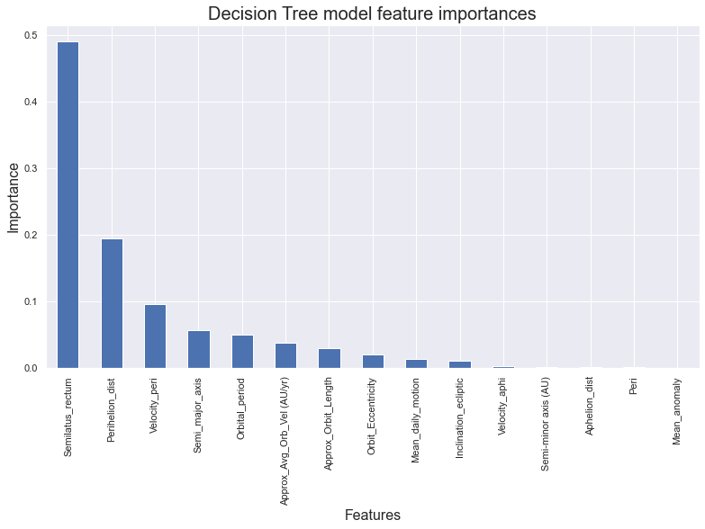
Decision Tree Continued
Model had only 10 misclassifications among the approx. 60000 strong test set
Extreme accuracy may be due to features being very closely tied to orbit type
Plot of model feature importances shows focus on just a couple features - particularly semi-latus rectum
Hyperparameter tuning considered but deemed unnecessary due to the evaluation metrics achieved

Slide 14
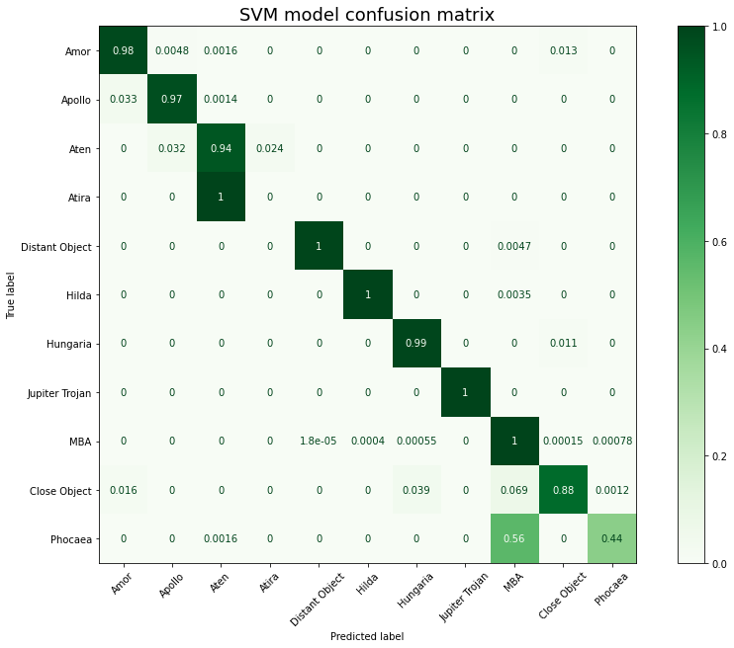
SVM
Wanted to test out another Linear model for comparison to LogReg
Specifically used a LinearSVC due to its inherent multi-class support with multi-class hyperparameter set to crammer singer and effectiveness on larger datasets
Was quite effective, with very similar results to the LogReg model
Accuracy score = 0.989081
Macro Avg. precision, recall and f1-scores of 0.87, 0.83, and 0.85
Like LogReg missed Atira and had difficulty with Phocaea (though improved slightly)
Model strongly utilized two features - Orbit Eccentricity and velocity aphelion

Slide 15
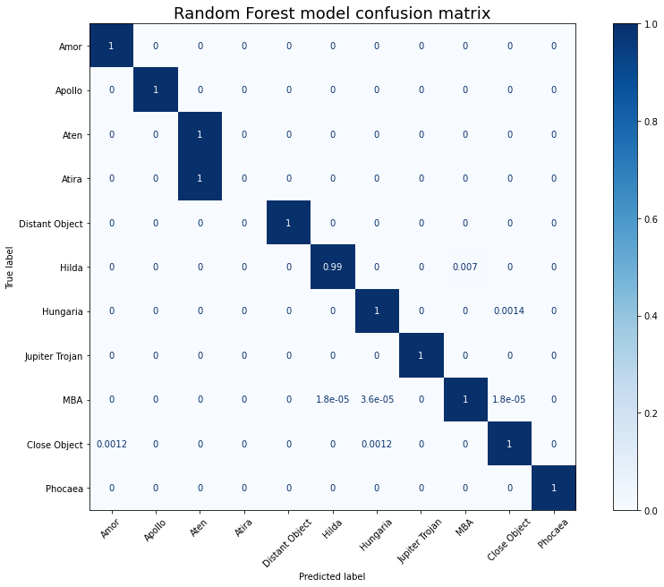
Random Forest Classifier
Implemented to compare effectiveness to the Decision Tree model
Consistently performs well in classification applications
Unsurprisingly performed overall very similarly to DT model - accuracy score of 0.999784
Macro avg. precision, recall, and f1-scores of 0.91 each
The normalized confusion matrix highlights the difference in scores - this model again missed on the Atira class

Slide 16
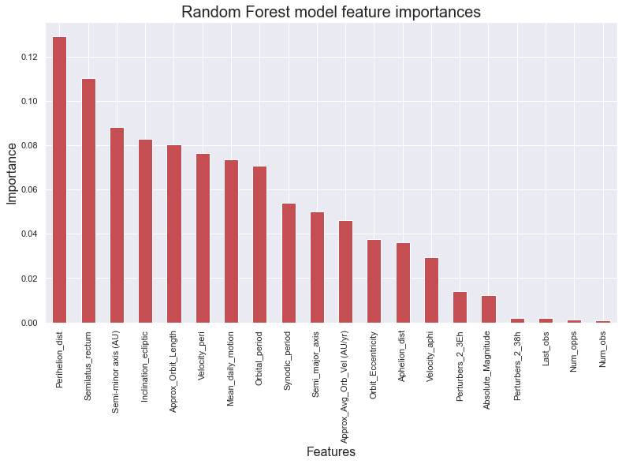
Random Forest Details
Outside of Atira class it’s predictions were essentially identical to DT model
Figure here shows the models feature importances
Interestingly utilizes more features than DT model but does share the same top two (though reversed
As in DT model hyperparameter tuning was considered but not necessary - best we could hope for was to match the DT model using a more complex model

Slide 17
Neural Network
Lastly a Neural Network was tried on the dataset - implemented using Keras
Never expected to actually use as final model in this problem, just wanted to try a simple, straightforward NN and compare its effectiveness
Tried variety of optimizers - Adamax performed best
Used simple sequential model with five layers and 100 nodes on inner layers
Performed quite well, especially given minimal tuning
Accuracy score of 0.996528 with a loss of 0.038895

Slide 18
Model Metrics Comparison
Model | Accuracy score | Precision (macro average) | Recall (macro average) | F1- score (macro average)
Logistic Regression | 0.988273 | 0.86 | 0.83 | 0.84
Decision Tree Classifier | 0.9998 | 1.00 | 1.00 | 1.00
SVM (linearSVC) | 0.989801 | 0.87 | 0.83 | 0.85
Random Forest Classifier | 0.999784 | 0.91 | 0.91 | 0.91

Slide 19
Final Model Choice: Decision Tree
As evidenced in the metrics table it outperformed all the other models in every evaluation metric, and was also very fast and relied on few features

Slide 20
Summary
Goal was to create model to predict the class of orbit type for Asteroids
Multi-class classification problem with eleven classes and large imbalance - approx. 90% of Asteroids were of MBA (Main Belt Asteroid) orbit type
Large dataset containing all observed Asteroids was used, and was cleaned, thoroughly examined and properly pre-processed in preparation for modeling
Variety of machine learning algorithms were tried - (Logistic Regression, Decision Tree, SVM, Naive Bayes, Random Forest, simple Neural Network)
Most performed very well; ultimately Decision Tree model was chosen to be the final model due to its exceptional effectiveness as evidenced by its metrics and its simplicity
Overall learned quite a bit and mostly satisfied with results

Slide 21
Further Recommendations
Looking back in hindsight and after consideration there are a few things I would consider doing differently or exploring given more time
Possibly trying out an XGBoost model and comparing its relative effectiveness
Performing some further feature selection through dimensionality reduction and assessing its impact on the models
Appears many features could probably be cut while retaining the strong evaluation scores
Trying out some combination of methods to make dataset less imbalanced and see the resulting effect
Undersampling MBA class, upsampling Atira and possibly a few other classes, or using SMOTE
Spend more time tuning Neural Network

